Slide 1
2018 Utah Tax Reform Working Proposal
Rep. Steve Eliason and Sen. Howard Stephenson
Co-Chairs, Revenue and Taxation Interim Committee

Slide 2
Principles of Good Tax Policy
Utah’s tax system should be:
Simple
Economically neutral
Reliable
Equitable
Responsive to interstate and international competition
Designed to minimize burdens of compliance and administration
Accountable and transparent

Slide 3
Proposals
Expand single sales factor
Clarify nexus for corporate income tax
Repeal net operating loss (NOL) carryback
Increase accountability for income tax credits for businesses
Give electric vehicle owners the option of paying a registration fee or participating in a VMT program
Sales taxation of streamed media and amusement devices
Exempt business personal property less than $1,000
Expand the manufacturing sales tax exemption to include:
Materials used or consumed in the manufacturing process
Machinery, equipment, and parts with less than a three-year economic life
Standardize rate cap for the School Board Local Levy
Freeze the State Basic Rate
Allow a portion of inflationary adjustments on the certified tax rate for all local governments and school districts
Simplify Truth In Taxation newspaper ad

Slide 5
Pre-and Post-Truth in Taxation Law
This law has done more to curtail irresponsible property tax increases prior and during the early 1980s.
At the time the law was passed, Utah ranked 24th highest among the 50 states in the percent of personal income taken by property taxes at 3.54%.
According to the most recent calculations, Utah ranks 34th at 2.49% of personal income.

Slide 6
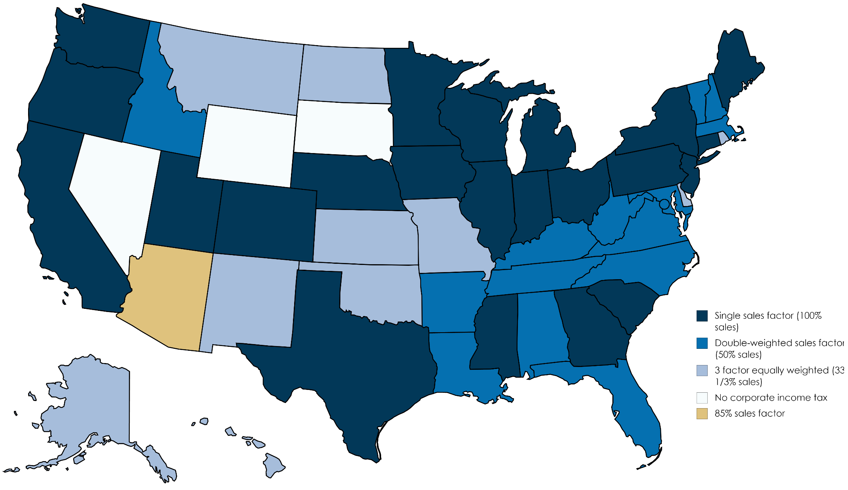
Utah Corporate Income Tax – State Apportionment Formulas
Source: Tax Foundation

Slide 7
State Apportionment Formulas for Manufacturing Industry
Source: Various state statutes
Notes:
State corporate income tax is one factor businesses consider when investing or expanding (it isn’t the only factor but it is one of them). Businesses that rely heavily on capital and payroll (such as manufacturers) are less likely to come to or expand in states that apportion business income based on property and payroll. Research* shows that changing from a double weighted sales factor to a single sales factor could increase manufacturing employment by 1.5% to 3.3%. As demonstrated by the graph, states believe the research so they are decreasing apportionment weights on payroll and property (by increasing the weight on the sales factor.
*Goolsbee, Austan, and Edward L. Maydew. "The Economic Impact of Single Factor Sales Apportionment for the State of New York." New York, NY: The Public Policy Institute of New York State, Inc., November, 2000.
Elder, Leif. Masters Project. “State Income Apportionment Formulas: Just Wait . . . the Weights Really Do Matter.” Spring 2017. (Advisory Committee: Professors Richard Fowles, Chair, Thomas Maloney, and Mark Glick).

Slide 8
Comparison of Sales Tax Exemption for Business Inputs Across the U.S.

Slide 9
Sales tax base as a percent of personal income and GDP is eroding
Notes:
Our economy is changing but our tax system is not.
We are no longer taxing what people are consuming.
Consumers are buying more services and digital goods.
They prefer experiences over things.
As a result, the sales tax base as a proportion of personal income and economic activity is declining over time.

Slide 10
Utah has become more heavily reliant on personal income tax
Notes:
The State has become more heavily reliant on personal income tax.
Some of this was caused by past tax policy, like 2008 tax reform.
This slide shows our income tax base as a proportion of federal adjusted gross income, and you can see that policy break in 2008.

Slide 11
Utah has become more heavily reliant on personal income tax
Notes:
Growth rates in our major tax systems are diverging.
The combination of that income tax policy choice from the last slide, the fact that we traded part of that increase for lower sales tax on food, and the changing consumption patterns I showed you two slides ago has led income tax to become a larger and larger part of our funding mix as shown in this slide.

Slide 12
Our Schools Now
Proposal
($715 million)
Notes:
Yet, there’s growing concern that our revenue won’t support our current “lifestyle” in the long-run.
Evidence of that is our propensity to borrow money in an expanding economy.
Because we’re not addressing the base, outside groups yearning for revenue are calling for increased rates
The Our Schools Now statewide initiative proposes, in part, to increase income tax rates – which makes our dependency and volatility problems worse.
Their proposal is:
Increase individual income tax rate from 5% to 5.45%
Increase state sales tax rate form 4.7% to 5.15%
Transfer the money generated to a restricted account.
Provide funding for both Public and Higher Education.

Slide 13
Proposals
Expand single sales factor
Clarify nexus for corporate income tax
Repeal net operating loss (NOL) carryback
Increase accountability for income tax credits for businesses
Give electric vehicle owners the option of paying a registration fee or participating in a VMT program
Sales taxation of streamed media and amusement devices
Exempt business personal property less than $1,000
Expand the manufacturing sales tax exemption to include:
Materials used or consumed in the manufacturing process
Machinery, equipment, and parts with less than a three-year economic life
Standardize rate cap for the School Board Local Levy
Freeze the State Basic Rate
Allow a portion of inflationary adjustments on the certified tax rate for all local governments and school districts
Simplify Truth In Taxation newspaper ad

Slide 14
2018 Utah Tax Reform Working Proposal
Rep. Steve Eliason and Sen. Howard Stephenson
Co-Chairs, Revenue and Taxation Interim Committee

